Slide 1
Project “Daniel”
Data Analysis
SingMass 27 February 2023

Slide 2
Missing values
Following species had missing values in at least one experimental group:
- COH 161, Cer d18:2/24:1, PE-P 18:0/18:2, SM 42:1, Sph d18:1

Slide 3
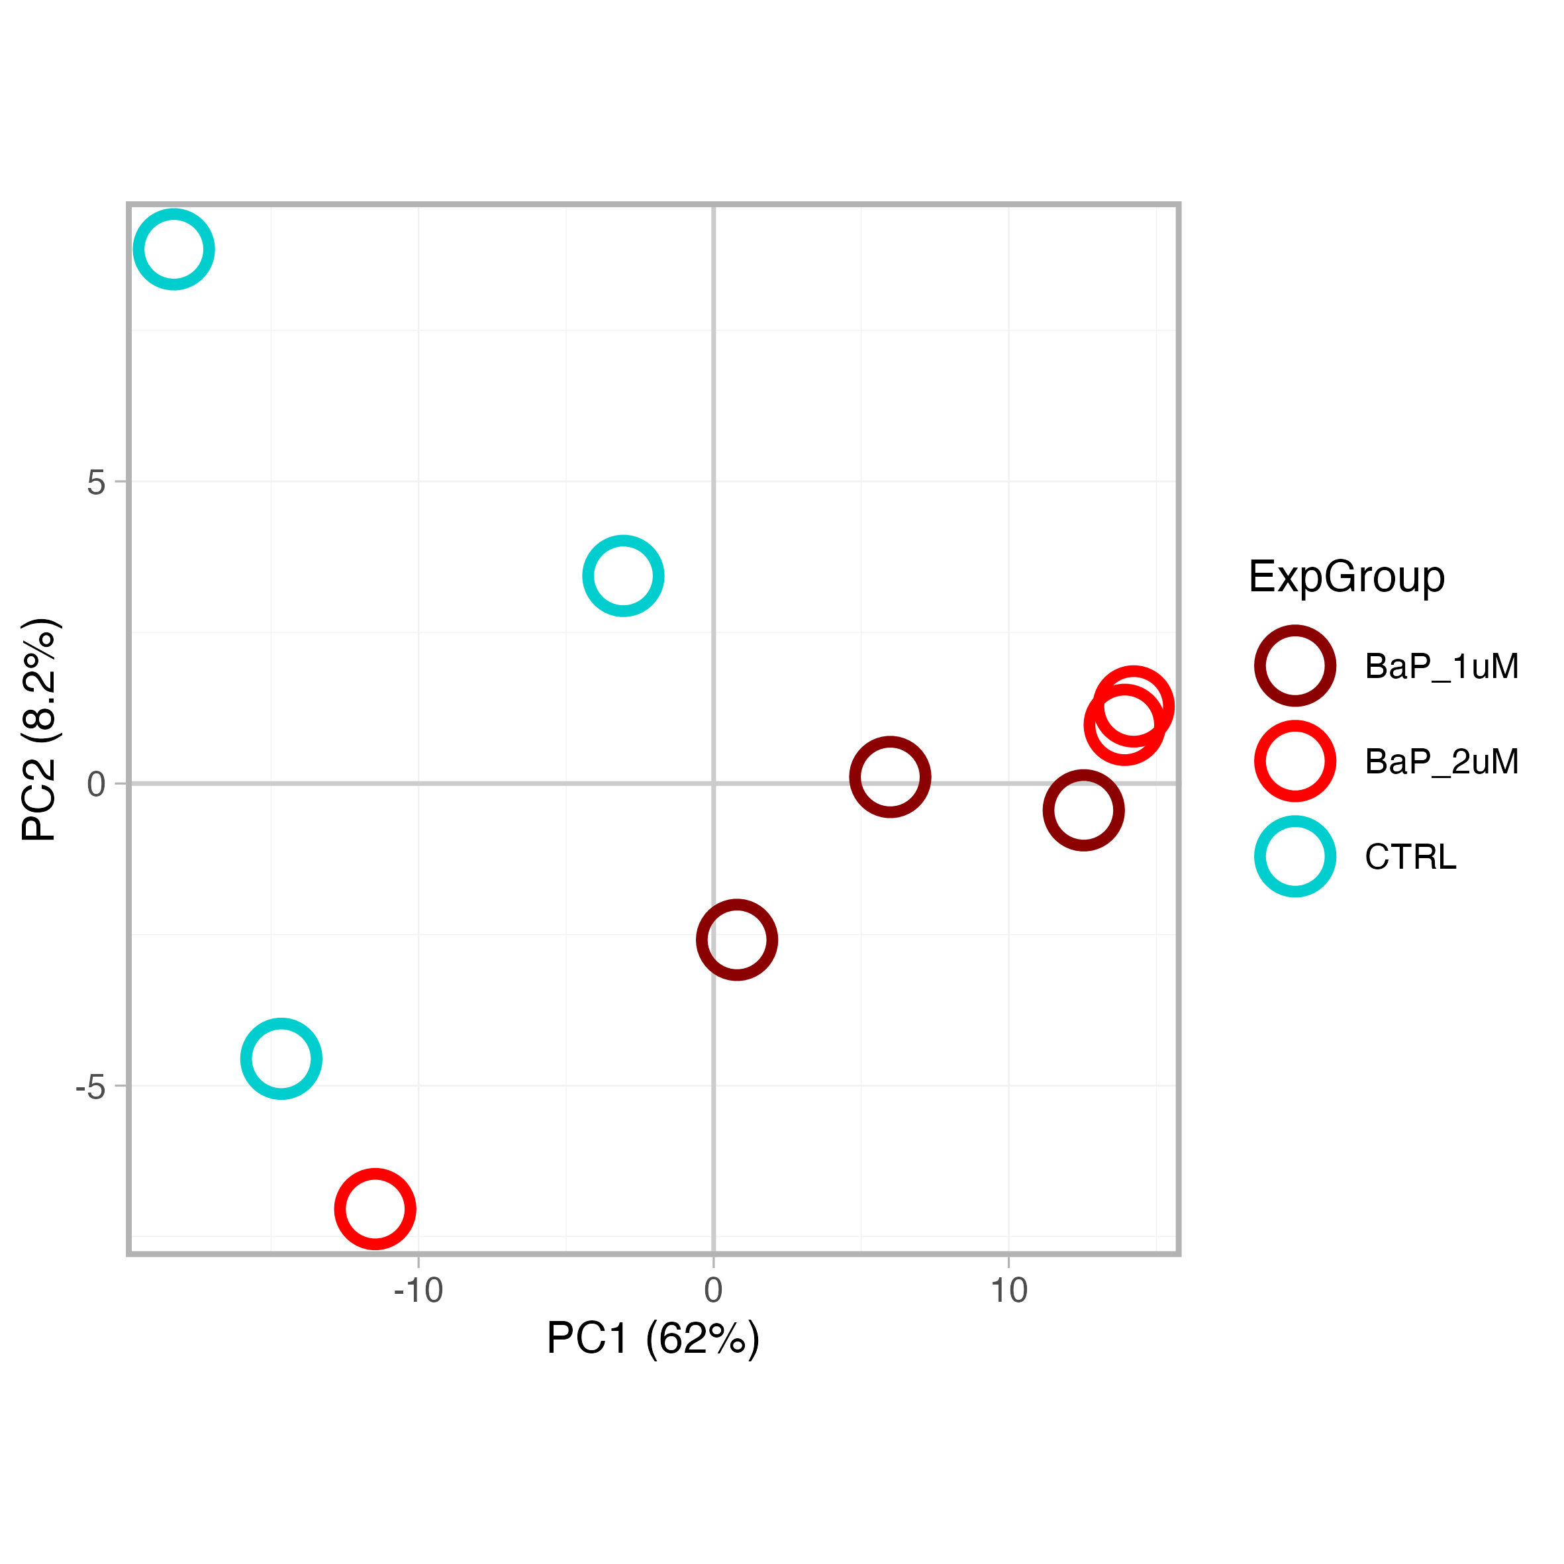
PCA

Slide 4
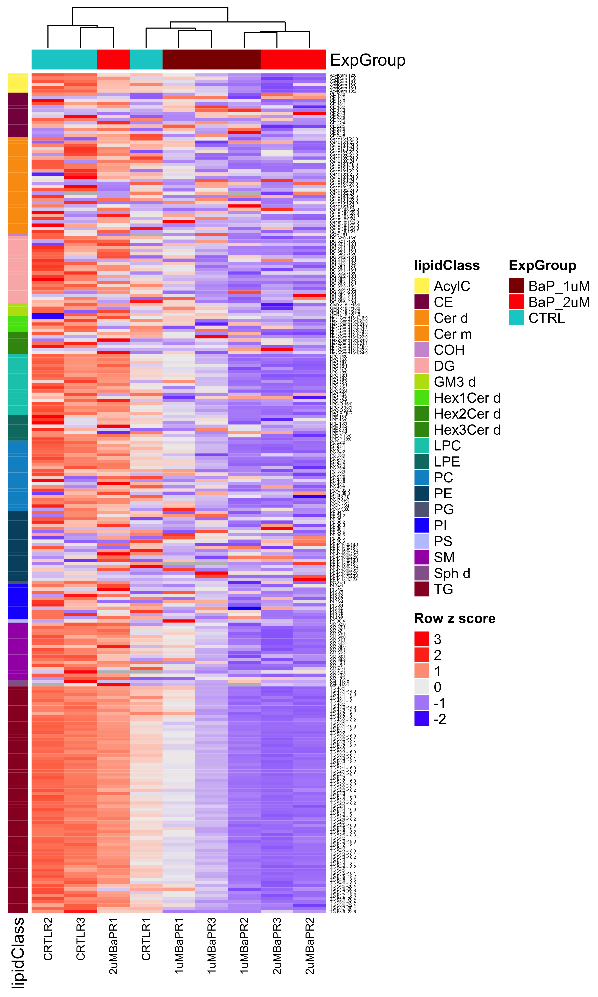
Clustering

Slide 5
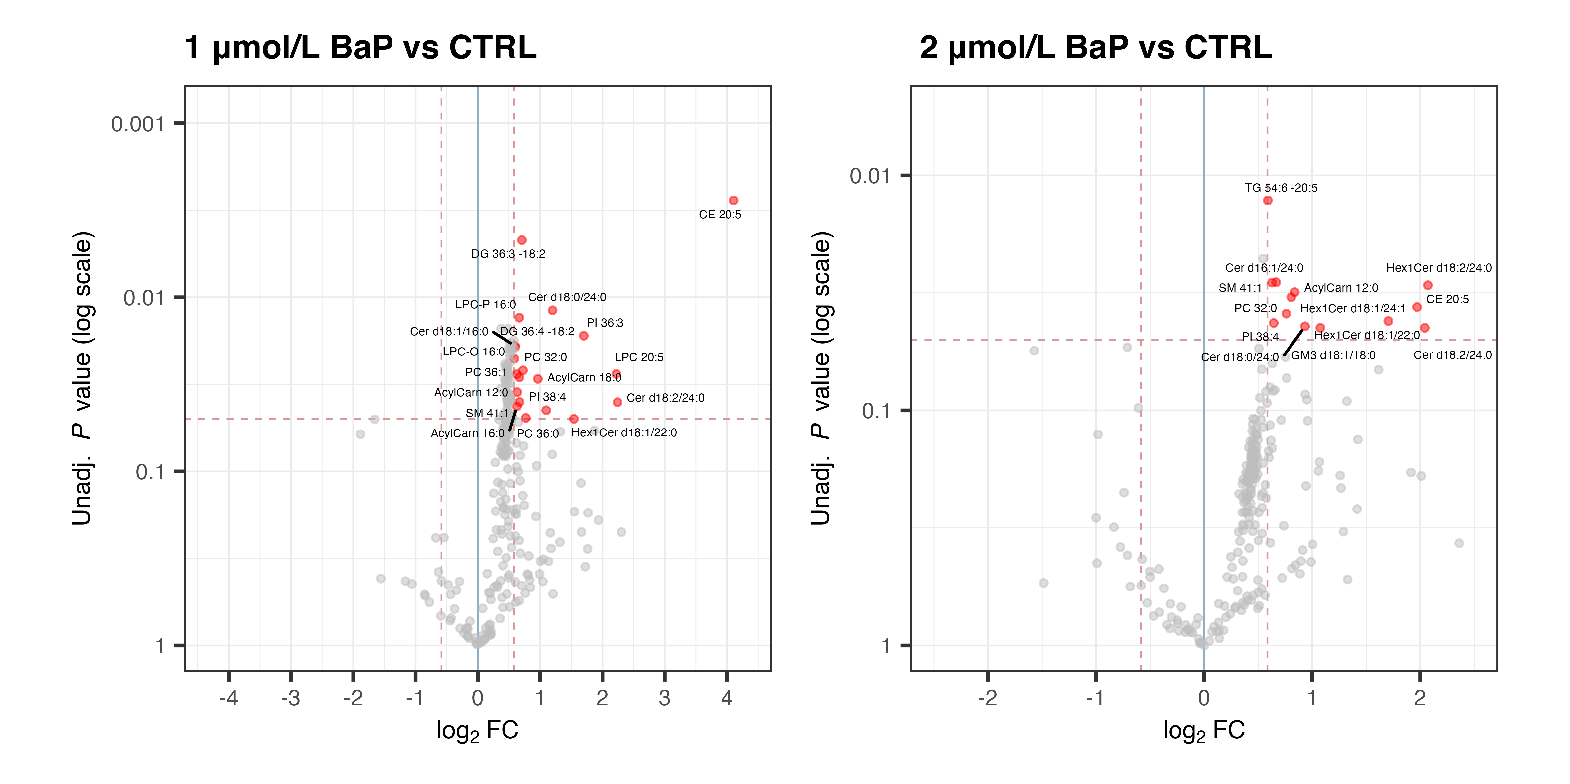
Statistical tests

